Slide 1

#NTfuelingOURfuture

Slide 2
National Trail High School
CLASS OF 2030
#ItsBETTERtobeaBLAZER

Slide 3
Introductions
Jeff Schmidt - HS Principal
Kelly Stanley - HS Administrative Assistant
Saharra Williamson - 9-12 School Counselor
Michelle Collins - TAG Administrative Assistant
Heather Leis - Advisor

Slide 4

Jostens Ring Order
Tuesday, Aug. 25th Freshman Ring Meeting
Wednesday, Sept. 3rd Order Day (During Lunch)
Wednesday, Sept. 8th Order Deadline
Wednesday, Nov. 18th Ring Delivery Day

Slide 5
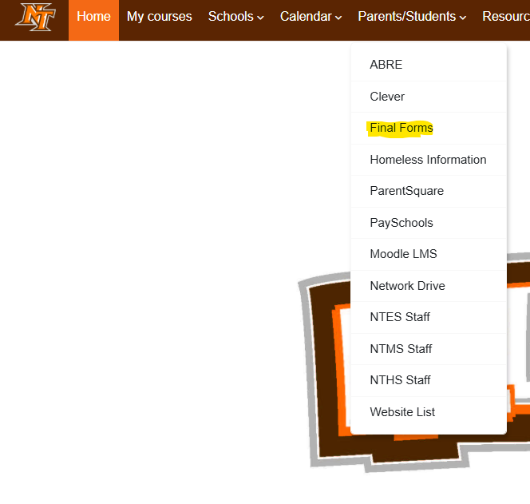
Final Forms
Due August 28th
A way to update student information.
Carries over from year to year.
Check the school website to access Final Forms.
Must be filled out to take part in ANY school activities.

Slide 6
Building Expectations
Fresh Start
Some advice:
  Do your best each day
  RESPECT! “You need to give respect to get respect”
  NTHS GOLDEN RULE - Rule #1 – “If a staff member asks you to do something…”
  YOU CONTROL YOUR FUTURE!
Be at school – Attendance is important
Keep up with your credits
Come prepared for success
Ask for Help!
Don’t interfere with other students’ education!

Slide 7
New Expectations
No cell phones/smart watches
  Turned off and stored in your locker from 7:30 am-2:30 pm each day
  If you need to call home, come to the office.
  If you need to reach your student, call the HS office.
  You will need wired earbuds for your laptops (we are providing one set to everyone)
Locker usage is required
  Your laptop bag is acceptable to carry around
  Your backpacks or sports bags need to be in your locker
  Small handbags may be carried for personal items
  Budget time during bell changes
Make sure to follow dress code
  No hoods, sock hats, or blankets
  We shouldn’t see any stomachs or backs at any time (stretching, reaching up, etc).

Slide 8
AI Policy
In certain situations, AI (Artificial Intelligence) may be used as a learning tool or study aid. Students who wish to use AI for legitimate educational purposes must have permission from a teacher or an administrator. AI is not a substitute for schoolwork that requires original thought. The use of AI to take tests, complete assignments, write papers, or otherwise synthesize student work constitutes cheating or plagiarism.
AI is defined as Artificial Intelligence, Large Language Models, or Generative AI.
Students may not use AI, including AI image or voice generator technology, to imitate others, violate school rules, or violate district policies.

Slide 9
Attendance
ATTENDANCE DEFINITIONS
School Day is from 7:30 – 2:30
  Students should not be in the building prior to 7:15 – report to Cafeteria
  Bus Drop-off - Report to Cafeteria Immediately (Not in the Commons)
  Doors will Lock at 7:35
Tardy to School
  Be on time in class when bell rings
  Teacher Expectation
  Tardy Check-in
Unexcused Absences
  Magic Number is 2 – attendance monitoring begins/legal notices will be issued
Excused Absence
  10 or more in a year – County truancy officer/courts gets involved with high school
  4 or more in a quarter – grade drops to 59% or below
  If your child gets sick at school & goes to the nurse

Slide 10

First Day
What to bring
Where to report
Schedule
Lunch

Slide 11

NTLS Social Calendar
Every second Wednesday of the month is WEAR YOUR BLAZER to school.
NFL Kick Off Day
Homecoming
World Kindness Day

Slide 12
National Trail Athletic Code (Found on-line)
Eligibility - No Pass No Play
    Must Pass a minimum of 5 one credit classes
    CCP students – we will work with you on an individual basis bc college classes are worth more credits than high school classes.
    2.0 minimum GPA this year.
Bus Passes
  No Passes for HS Students except for academic purposes
  Bus is considered part of school day and all rules and expectations apply on the bus and at bus stops!
HARASSMENT, INTIMIDATION, OR BULLYING – Don’t Do It!

Slide 13
Splitting the Group
9th Graders - Please proceed to the HS Cafeteria to meet with Ms. Williamson
Parents - Please stay here in the Gymnasium with Mr. Schmidt

Slide 14
A little about me
Jeff Schmidt
10 years in education
2nd year as an administrator
Graduated from The University of Dayton
Taught Social Studies MS, HS
Coached HS Football
Grew up in NTLS. Very involved playing sports and FFA

Slide 15
Counseling Office
School Counselor- Ms. Williamson
School Counseling Secretary- Mrs. Collins
Individual Student Planning
Classroom Lessons
Responsive Services
  Individual & Small Group Counseling, Peer Mediation, Crisis Intervention, Consultation/Collaboration with parents, teachers, administrators, and outside agencies
What Happens in the Counseling Office?
Notes:
Brooklyn

Slide 16
HS Credit Requirements
A total of 23 credits are required for graduation from National Trail High School:
4.0 Credits in English
4.0 Credits in Mathematics (including Algebra II)
3.0 Credits in Science
3.0 Credits in Social Studies (World, American & Government)
.5 Credits in Physical Education (2 - ¼ credits classes)
.5 Credits in Health
1.0 Credits in Business/Computer
1.0 Credit in a Unified Art
Unified Arts include: Art, Music, Any Agriculture Class, French, Spanish, Business/Computer, Family and Consumer Science, or Graphic Design class
1.0 Credit in a Fine Art
Fine Arts include: Band, Steel Band, Choir, Guitar, Music Appreciation, Art and Graphic Design
5.0 Elective Credits
More detailed information can be found in the National Trail High School Course Guide
Notes:
Brooklyn

Slide 17
What is a Credit?
How do you gain a credit?
  Semester 1 AVERAGE + Semester 2 AVERAGE = Final Grade
  Final Grade of 60% or Higher = Credit
  What is a semester exam (20% of final grade)
“Retention” Policy
  5 credits to be promoted to the 10th grade
  11 credits to be promoted to the 11th grade
  17 credits to be promoted to the 12th grade
Making up failed courses
  Summer school
  In schedule
  Credit Recovery - Last resort
Notes:
Brooklyn

Slide 18
Graduation Requirements Class of 2029 and Beyond
1st: Cover the basics
  Meet graduation requirements (23 credits)
2nd: Show competency
  Earn a passing score on Ohio’s high school Algebra I and English II tests OR
  Option 1- Demonstrate two career-focused activities
Option 2- Enlist in the military
Option 3- Complete college coursework in math or english
3rd: Show readiness
  Earn two diploma seals that line up with your goals and interests. At least one of the two must be Ohio-design.
*These requirements can also be found in the NTHS Course Guide
Notes:
Brooklyn

Slide 19
Parent/Teacher/Admin Partnership
We are all here for the same goal - to get your student a diploma.
Communication is KEY
  Email
  Phone Calls
  Conferences
If there is an issue…
  …in class, start with the teacher
  …with a coach/advisor, contact them first
  …with peers, contact Mr. Schmidt
If the issue is not resolved with the teacher/advisor, call/email Mr. Schmidt. For coaches, contact Mr. Ferguson.

Slide 20
How we can work together
Sleep is key for learning!
Communicate your concerns & vice-versa - email and phone calls are helpful if there is an issue.
Follow grades on Moodle- these are updated weekly
  If you need logins & passwords, contact the HS Office
Keep an eye on your child’s cell phone activity
  This is where we see the most harassment/bullying
Let us know if you see changes in behavior & vice versa
Encourage them to be involved in some way
  Clubs, the arts, athletics, etc.
Help them set short-, mid-, and long-term goals

Slide 21
Discipline
Three common disciplinary outcomes
  Detention (most common)
  ISD - In School Detention
  Out of School Suspension
Detention runs from 2:35-3:30pm - they must get their own ride home
ISD is in the Credit Recovery Room and monitored by Mr. Moore (Could Change Rooms)
OSS is a last resort and reserved for significant disciplinary issues
If ISD or Suspension is used, you will hear from me

Slide 22
High School Tech
Laptop 1:1
BYOL (Bring Your Own Laptop)
Moodle
Electronic Communications
Laptop must be charged
Don’t damage/decorate the device or bag

Slide 23
Daily Schedule
NTHS utilizes a Block Schedule
Schedule of days can be found on the website
  Brown Day and Orange Days – Alternate each day
    4 Classes Each Day
    82 Minute Class Periods
    30 Minute Lunch
    30 Minute Blazer Time
      Used for Clubs
    30 Minute Intervention
    3 Minute Class Change
      7 Minute Class Change between 1st Block and 2nd Block
        2nd Chance Breakfast

Slide 24
E+R=O
Event + Response = Outcome
“I don’t control events. I do control my response.” - Brian Kight

Slide 25

Disciplined vs. Default Responses & Being Above the Line

Slide 26
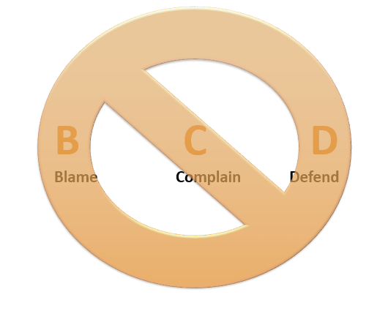
No BCD

Slide 27
20 Sq. Ft.
This is everyone in your circle
Your interactions with them are EVENTS
Your RESPONSES and their RESPONSES will affect the OUTCOME
As a school, this means doing your best to make every interaction positive.

Slide 28
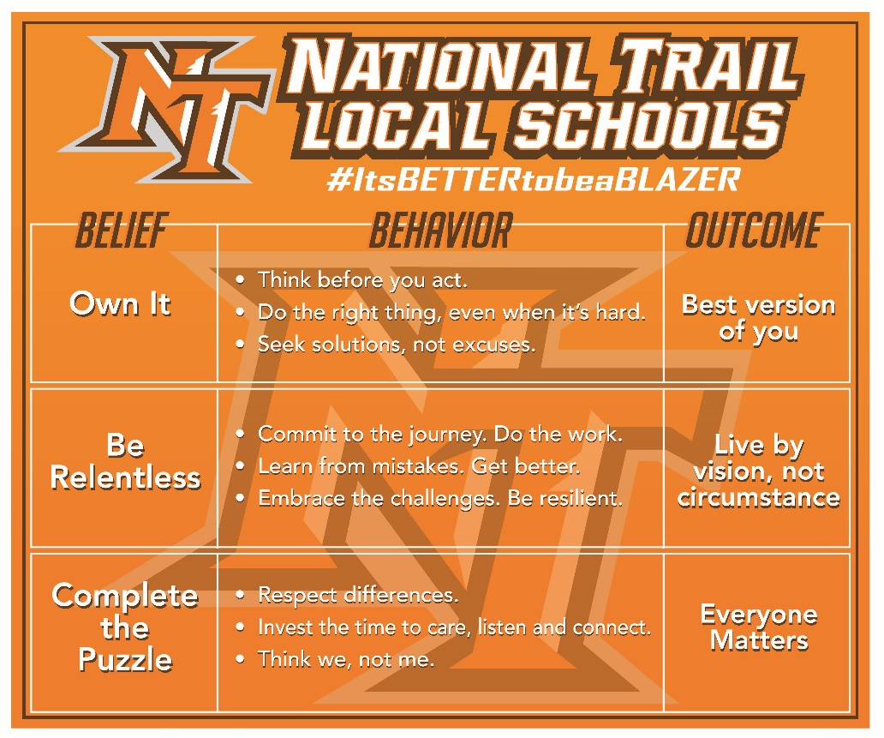
THE R FACTOR

Slide 29
HIGH SCHOOL COMMUNICATION SH
Twitter
  @NationalTrailAD
  WEBSITES
  www.blazerathletics.org
  www.nationaltrail.k12.oh.us
Facebook
  National Trail Local School District
Email Communication
  Morning Announcements
  Scholarship Information
  ParentSquare

Slide 30
ParentSquare
There is a Direct Messaging Feature
Set up your method of alert
Check for updates and reminders

Slide 31
Remember the goal
GRADUATION
In May of 2030

Slide 32

Important Dates
Thursday, August 20th- First Day of School 7:30 am
Monday, September 7th- No School
Friday, September 4th- Commit to Graduate
Thursday, September 24th- HS/MS Picture Day
Thursday, September 24th- HS Conference Night
3:00 pm-6:30 pm
Friday, September 25th- No School/PD Day

Slide 33


Thursday, August 20th 7:30 am

